Slide 1
Unit 3
Addition & Subtraction of Polynomials
Algebra 1

Slide 2
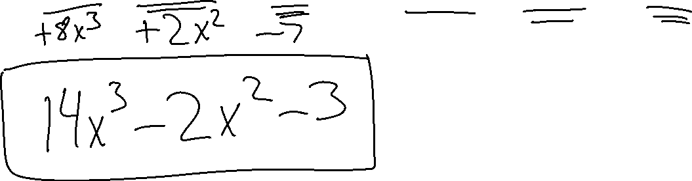
Adding Polynomials
${(6x}^{3}−{4x}^{2}+4)+$ ${(8x}^{3}+ {2x}^{2}−7)$

Slide 3
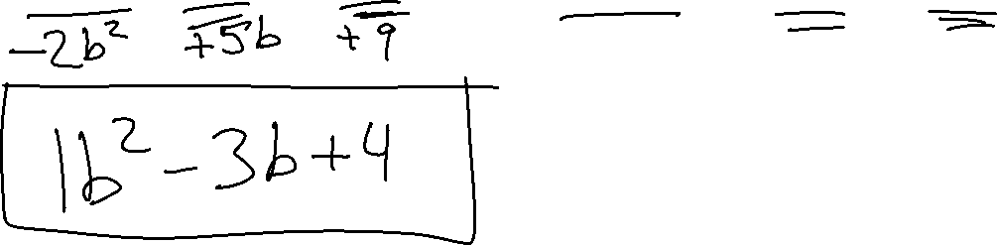
Adding Polynomials
${(3b}^{2}−8b−5)+$ ${(−2b}^{2}+5b+9)$

Slide 4
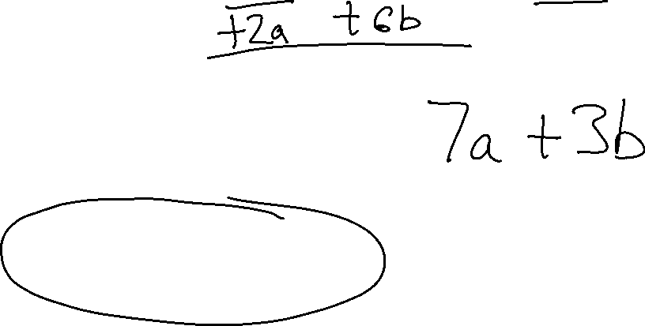
(5a – 3b) + (2a + 6b)
3a – 9b
3a + 3b
7a + 3b
7a – 3b

Slide 5
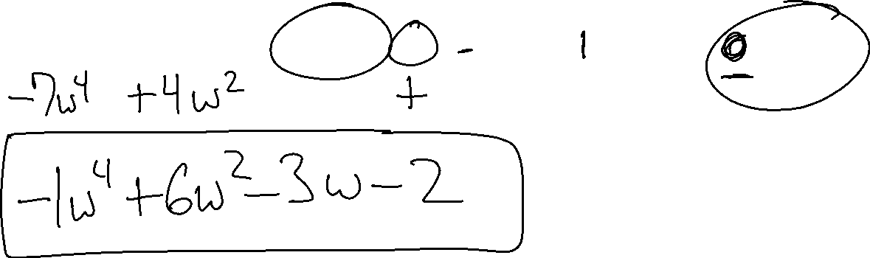
Subtracting Polynomials
${(6w}^{4}+2w^{2}−2)−$ ${(7w}^{4}−{4w}^{2}+3w)$

Slide 6
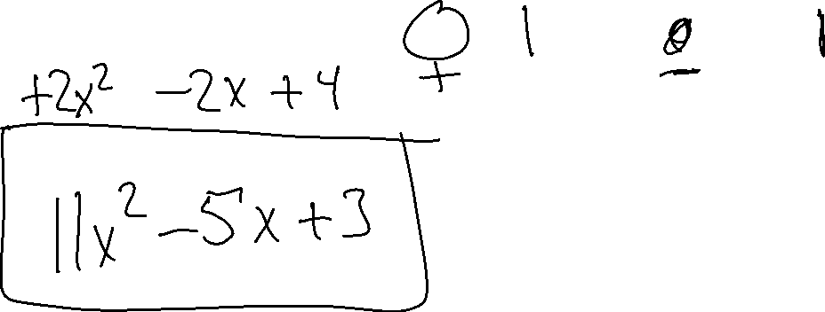
Subtracting Polynomials
${(9x}^{2}−3x−1)−$ ${(−2x}^{2}+2x−4)$

Slide 7
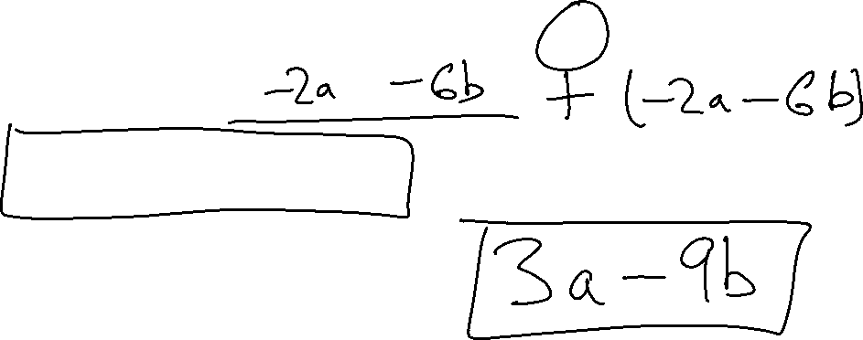
(5a – 3b) – (2a + 6b)
3a – 9b
3a + 3b
7a + 3b
7a – 3b

